Slide 1
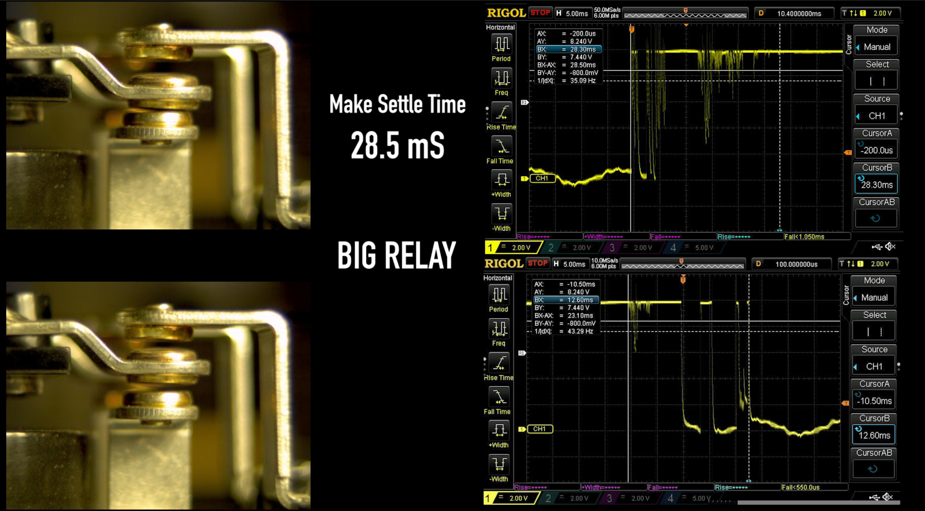

Slide 2
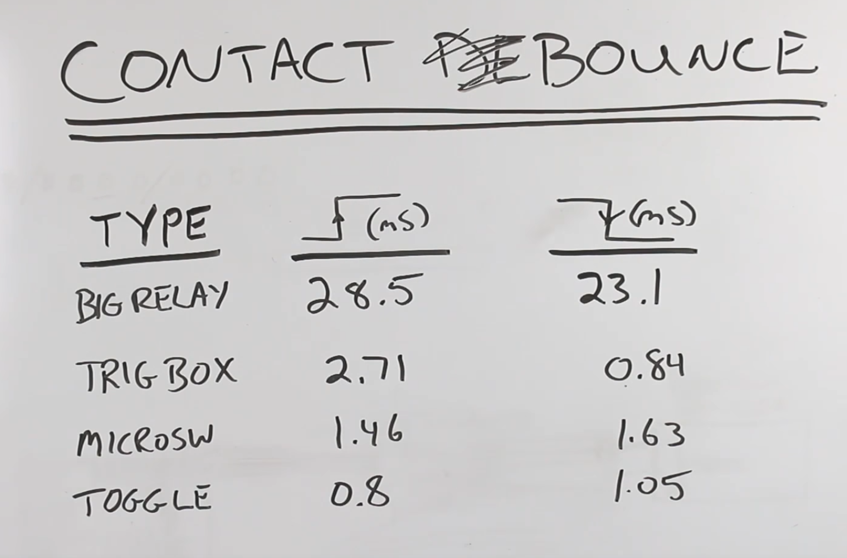
Switch Activated
Open to Close
Switch Deactivated
Close to Open
Notes:
https://youtu.be/jI-rC2FCKo4

